Slide 1
Unit 3 Resistance & Ohm’s Law
Part B: Resistor Colour Code
Notes:
Hi! Welcome to Unit 1: Quantities and Units, Part A on Electrical Units.

Slide 2
What will you learn?
What is resistor colour coding?
Purpose of colour coding.
How to read the resistance and tolerance value from a colour code?
Notes:
The objective of this unit is to get familiar with and to explain commonly used electrical quantities and their units.

Slide 3
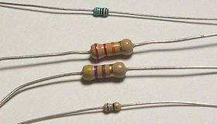
What is a resistor colour code?
A resistor colour code is displayed in colour bands.
It is a practical way to use colours to indicate a resistance value and the tolerance.
Notes:
The objective of this unit is to get familiar with and to explain commonly used electrical quantities and their units.

Slide 4
What is a resistor colour code?
10 colours are used to represent resistance values:
Black (0), Brown (1), Red (2), Orange (3), Yellow (4), Green (5), Blue (6), Violet (7), Grey (8), White (9)
Number indicated can be numerical or multiplier
There are 3-band, 4-band, 5-band and 6-band colour codes.
4-band system is the most common.
Notes:
The objective of this unit is to get familiar with and to explain commonly used electrical quantities and their units.

Slide 5
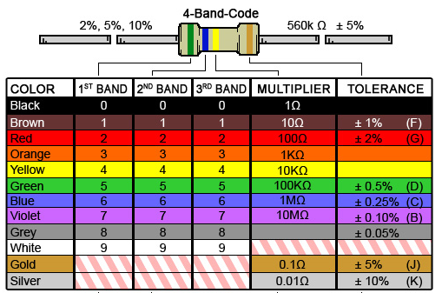

4-Band Colour Code
First three bands indicate the resistance value.
First and second band indicate two digits respectively.
Third band is the multiplier.
Fourth band specifies the tolerance.
Notes:
The objective of this unit is to get familiar with and to explain commonly used electrical quantities and their units.

Slide 6

Illustration 1: Reading a resistor colour code
You are given a resistor using a 4-band colour code.
It displays from leftmost: Yellow, Violet, Orange and Gold.
From the chart it reads
Yellow Violet Orange Gold
4 7 ×10³ Ω ±5%
= 47×10³ Ω ± 5%
= 47000 Ω ± 5%
= 47 kΩ ± 5%
Notes:
Eager to find out what they all represent? In fact, you have just seen some of the common electrical terms listed here. That is, electrical quantities and units.
Each quantity and unit can be represented by their respective symbols.
Voltage has a symbol V, and its unit volt by V.

Slide 7
Illustration 2: Reading a resistor colour code
You are given a resistor using a 4-band colour code.
It displays from leftmost: Green, Blue, Yellow and Gold.
From the chart it reads
Green Blue Yellow Gold
5 6 ×10⁴ Ω ±5%
= 56×10⁴ Ω ± 5%
= 560,000 Ω ± 5%
= 560 kΩ ± 5%
Notes:
Eager to find out what they all represent? In fact, you have just seen some of the common electrical terms listed here. That is, electrical quantities and units.
Each quantity and unit can be represented by their respective symbols.
Voltage has a symbol V, and its unit volt by V.

Slide 8

Illustration 3: Reading a resistor colour code
You are given a resistor using a 4-band colour code.
It displays from leftmost: Brown, Black, Brown and Gold.
From the chart it reads
Brown Black Brown Gold
1 0 ×10¹ Ω ±5%
= 10×10 Ω ± 5%
= 100 Ω ± 5%
Notes:
Eager to find out what they all represent? In fact, you have just seen some of the common electrical terms listed here. That is, electrical quantities and units.
Each quantity and unit can be represented by their respective symbols.
Voltage has a symbol V, and its unit volt by V.

Slide 9
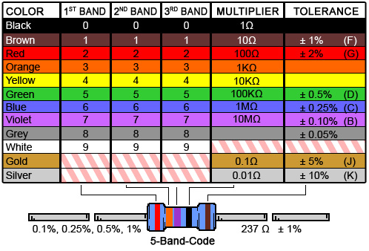
Illustration 4: 5-Band Colour Code
First four bands indicate the resistance value
First, second and third band indicate three digits respectively
Fourth band is the multiplier
Fifth band specifies the tolerance
Notes:
The objective of this unit is to get familiar with and to explain commonly used electrical quantities and their units.

Slide 10
Memorising the resistor colour code
Some mnemonics are helpful in memorizing the code.
The first letter of the colour code is matched by order of increasing magnitude.
Two examples which are popular:
Big boys race our young girls but Violet generally wins.
Big brown rabbits often yield great big vocal groans when gingerly slapped.
o
y
w
o
y
w
s
Notes:
Eager to find out what they all represent? In fact, you have just seen some of the common electrical terms listed here. That is, electrical quantities and units.
Each quantity and unit can be represented by their respective symbols.
Voltage has a symbol V, and its unit volt by V.

Slide 11
Nominal resistance value and tolerance
It is neither economical nor practical to produce resistors with exact resistance values.
A more practical solution is to produce resistors of nominal values with small but predictable deviation.
Example: A resistor colour code reads 470 Ω ± 5% means that
Nominal resistance value = 470 Ω
Minimum resistance value = 470 Ω × 0.95 = 446.5 Ω
Maximum resistance value = 470 Ω × 1.05 = 493.5 Ω
The actual resistance value lies within the range.
Notes:
Eager to find out what they all represent? In fact, you have just seen some of the common electrical terms listed here. That is, electrical quantities and units.
Each quantity and unit can be represented by their respective symbols.
Voltage has a symbol V, and its unit volt by V.

Slide 12
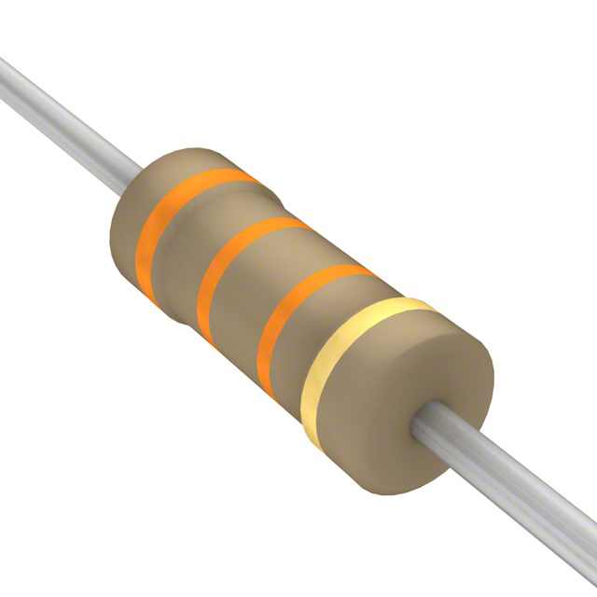
Illustration 5: Determine the minimum and maximum resistance values of a resistor coded in orange, orange, orange and gold.
From the resistor colour code chart
Nominal resistance value = 33 kΩ and tolerance = ±5%
Minimum resistance value = 33 kΩ × 0.95 = 31.35 kΩ
Maximum resistance value = 33 kΩ × 1.05 = 34.65 kΩ
If your circuit needs a resistor in the range of 32 kΩ to 34 kΩ, the 33 kΩ ± 5% resistor should not be used. It is because 31.35 kΩ & 34.65 kΩ are out of the required range. Use 33 kΩ ± 2% instead.
Notes:
Eager to find out what they all represent? In fact, you have just seen some of the common electrical terms listed here. That is, electrical quantities and units.
Each quantity and unit can be represented by their respective symbols.
Voltage has a symbol V, and its unit volt by V.

Slide 13
You have learned that
Gold or silver band forms the tolerance band in a 4-band colour code.
Colour bands are read from the left to right. Assume that the tolerance band is placed at the right hand side of the viewer.
First and second bands form the numerical values in a 4‑band colour code while the third band is the multiplier.
The tolerance band indicates the possible minimum and maximum resistances of the resistor.

Slide 14
Coming Up Next
Conventional Current and Reference Ground

